Slide 1
The Election
Sitakant Mahapatra

Slide 2
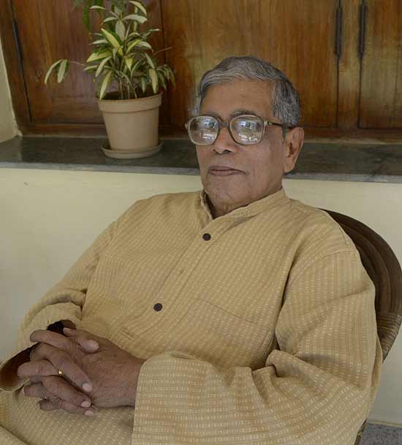

Slide 3
Sitakant Mahapatra is an Oriya writer belonging to the post-colonial era. In his writing he tries to go against the trend of romanticising the past and instead focuses on the reality of the present.

Slide 4
The poem The Election is based on the Postcolonial Disillusionment. The poem is a narrative of an election campaign in India. A politician is the narrator of the poem who has come to campaign for the votes in a remote village.
The poem is a satire on the ‘rule of people’ in India. In the beginning we find that he has criticized the politicians but with at the end of the poem, the criticism moves from the rulers to the commoners and failure of democracy is revealed.

Slide 5
Our jeep crawls to your village
seeking strange melodies
from the roaring sun:
‘the common will’
from the criss-cross geometry
of private agonies.

Slide 6
In the first stanza, the narrator i.e. the politician says to the villagers that the jeep of politicians ‘crawl’ on the road to reach them. The jeep does not run but crawl signifying the worst condition of roads in remote areas.
Rallies of the politician are accompanied with music, applaud, noise, hooting etc which is quite strange as such things rarely happen in the villages particularly under the burning sun.
All this happens for the sake of ‘the common will’ i.e. democracy which is very important in India (that is why he keeps the term in single inverted commas). The Politician forces the villagers to acknowledge the problems and difficulties he has faced by travelling to their village on criss-cross geometry i.e. irregular and rough roads.
If we go deeper into the words we find how politicians, who were supposed to be the servants of the public, ironically become their masters and vice versa. Thus now that the democracy has made them masters, their leaving of comfort zone for the people would be a kind of gratitude on people.

Slide 7
Our dark longings don’t touch you,
Nor our trappings
of posters, symbols, speeches, handbills,
for your grief outlives empires.

Slide 8
In the second stanza the politician says that the villagers are not affected by the ‘dark longings’ for power. The politician has worked hard in making posters, in campaigning, in delivering speeches, giving out handbills etc, however, the commons have their own sorrows and grieves that surpass the issues of the states.
However, it is the grieves of the commoners that help him to gain power. The politician emotionally trigger their problems to gain favour and ultimately succeed in gaining votes as well.

Slide 9
The cold grandchildren
awaken in your heart
As you discern
muted allegories
on our ashen faces.

Slide 10
In the third stanza, the narrator says that villagers have killed desires in their hearts as they know well that their condition will never be changed. However they have hope in their hearts that their future progeny may be able to live in a better way.
This makes them to look on the face of politician which is tired and ash coloured as he has left his comfort zone for the sake of votes.
In these lines, one can see how the people see their leaders. They think as if the politicians have some magical powers to do something for them. The people never try to bring the change on their own but instead put their hopes on the politicians. Hence they remain in the same condition for eternity.

Slide 11
Here the great persuaders
are little things, and not so hidden:
cheap plastic, cheaper nylon,
dark glasses to blot out the Sun.

Slide 12
In the fourth stanza the narrator expose the real face of democracy in India. According to him, it is not a hidden but a very common fact that in remote areas such as the one described in the poem the politicians do not do something big and extraordinary for the votes, but provide cheap things like plastic, nylon, glasses etc during the campaign.
Politicians thus succeed in blotting out the sun; they deviate people from the development and welfare by giving away the cheap goods (even tokenism happen only during the campaign).
Thus anti-democracy comes into existence.

Slide 13
With one foot in hunger
and the other in the soul,
you make your decision:
the anguish of choice.

Slide 14
In the last stanza, the narrator describes the failure of democracy caused, not by the politicians but by the commoners.
The people on one hand become selfish in their demands and ask for livelihood to the rulers at any cost. On the other hand they talk about the soulful things like basic rights, social change etc. They cannot decide to which side they should go and ultimately fail in making the right decision.
Thus social issues like inequality, class-divide and poverty is not because of politicians but because of the choice of people.
Hence the narrator explains how a task like election which was meant for the welfare of the people and which could bring about a change in the country becomes miserable event of corruption and malpractices.

